Slide 1

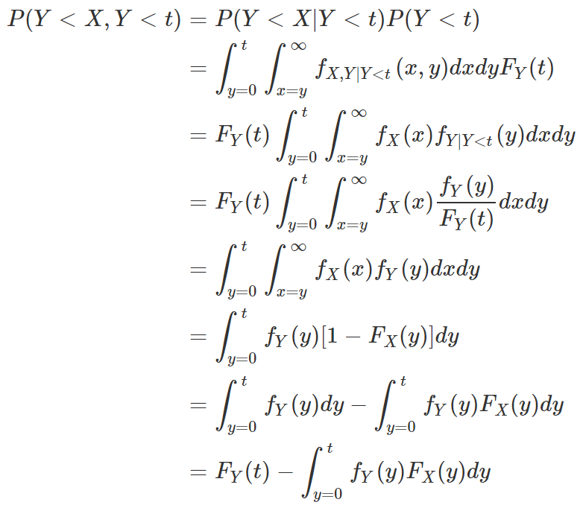
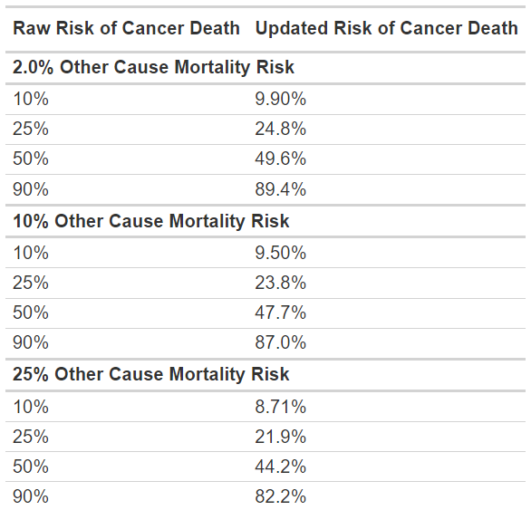
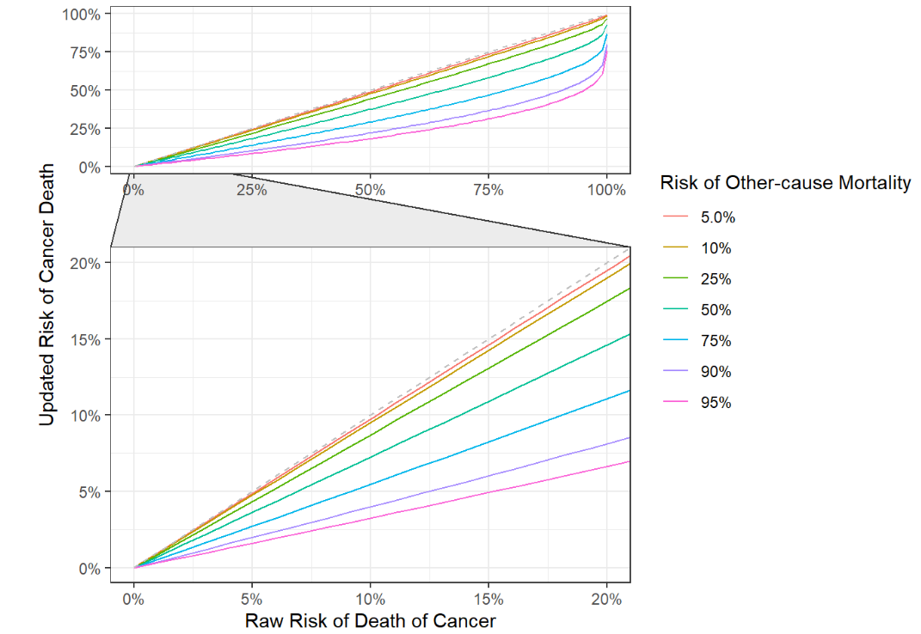


Estimation of Patient Death Accounting for Competing Events
Daniel D Sjoberg, MA; Andrew J Vickers DPhil
Prostate Cancer Clinical Trials Consortium; Memorial Sloan Kettering Cancer Center
Introduction
Results/Conclusions
Accurate estimation of a patient's risk of death is crucial for treatment planning and patient counseling—this is particularly true among cancer patients.
Large data sets suitable for creating risk prediction models for death for cancer, for example, will not include detailed information on patient comorbidities.
Conversely, large data sets with detailed information on comorbidities suitable for prediction of other-cause mortality will not include detailed information on cancer burden.
Take two patients with identical low-risk disease profiles. If the first patient is highly comorbid with low life expectancy and the second is healthy with a long life expectancy, a clinician may choose to aggressively treat the healthy patient and provide palliative care for the comorbid patient.
Indeed, the paradigm is outlined in various NCCN treatment guidelines.
To make this decision, a clinician must weigh the cancer risk against the patient’s risk of death from other causes. We are, therefore, in need of methods to combine risk predictions of death from cancer and death from other causes.
Herein, we present a simple and novel statistical method for combining these two risk estimates, and an R package for implementing the method.
Assume a patient presents with a risk of death from cancer of 20% within 10 years and an identical risk of death from other causes.
If we incorporate information about the patient’s chance of dying from other causes before the patient dies from cancer, our model estimates the risk of dying from cancer decreases to 18%.
The figure and table illustrate other risks of cancer death and death from other causes, and how probabilities change.
Simulated data shows the modifications to the probabilities result in improved model calibration, meaning patients’ and clinicians’ decisions about treatment or withholding treatment will be based on an improved probabilities, which translate to better care for patients.
Methods
Most risk prediction models provide a single estimate of risk of death from other causes or death from cancer.
For example, two calculators may give a patient a risk of death from cancer within 10 years of 15% and risk of death from other causes at 5% within the same 10-year period.
These risk estimates represent estimates that could have come from a larger survival curve.
By making a few assumptions about the shape and independence of these survival cures, we can correct a death from disease probability to account for the likelihood a patient succumbs to death from a cause unrelated to the disease of interest.
Let X and Y be independent random variables with support on (0,∞), and represent a patient’s risk of death from cancer and death from other causes.
We wish to solve for the probability that P(Y<X,Y<t) for some t>0 to make the correction outlined above.
That is, we wish to solve for the probability that a patient passes away from cancer before other causes and within t years.
We can make a simplifying assumption that X and Y follow two exponential distributions to solve for this probability.
The calculations have been available via an R package that can be installed from GitHub: http://www.danieldsjoberg.com/crc/

